Slide 7
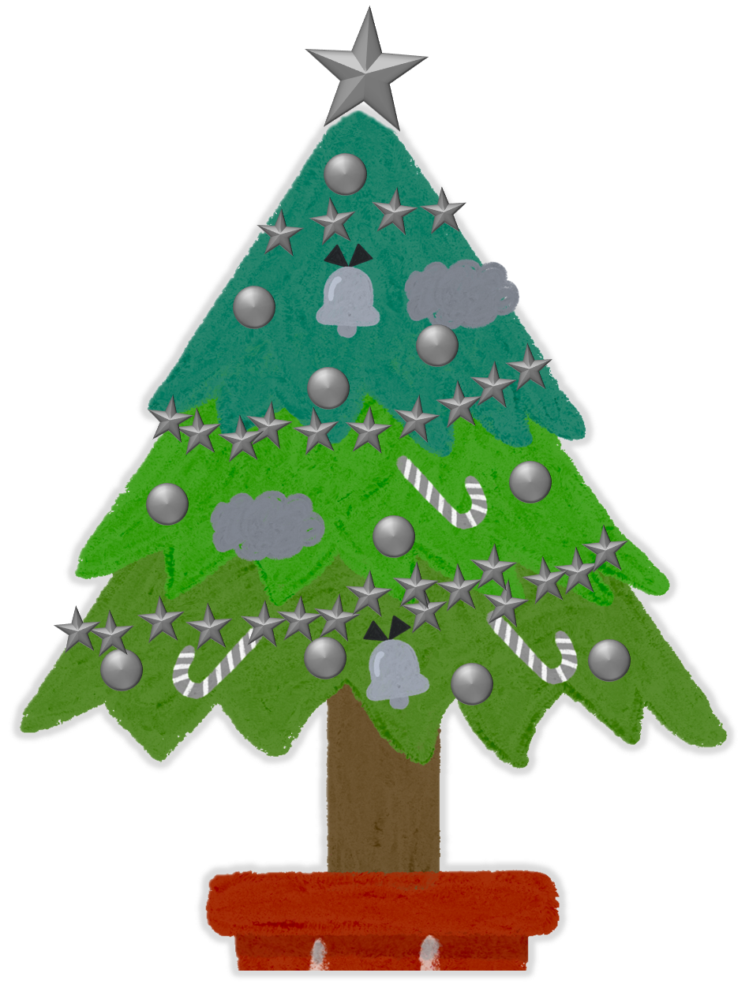
What happens when you microwave ice?
It shatters into pieces.
No change.
It melts.

